Slide 1

Machine Learning Course – Final Project
By Tom Geva & Maya Cohen

Slide 2
Baseline Model Data Savoring Technique
In our baseline model while performing the pre-processing we found that a third of the rows in the data had 5 or more of its features as a missing value.
Since we didn’t want to risk skewing the data due to a heavy bias present from imputing them, or to delete this many samples from the data, we made a compromised solution where we removed all of the samples that had more than 5 missing values, and randomly selected 3,300 rows to remove which had exactly 5 missing values.
after that process, we imputed all the missing values that were left using a KNN imputer function, these imputed values had a lot less weight in the data, creating only a light skew with low strength in its interpretation withing the data, which acts as a place-holder for the missing values that were there.

Slide 3
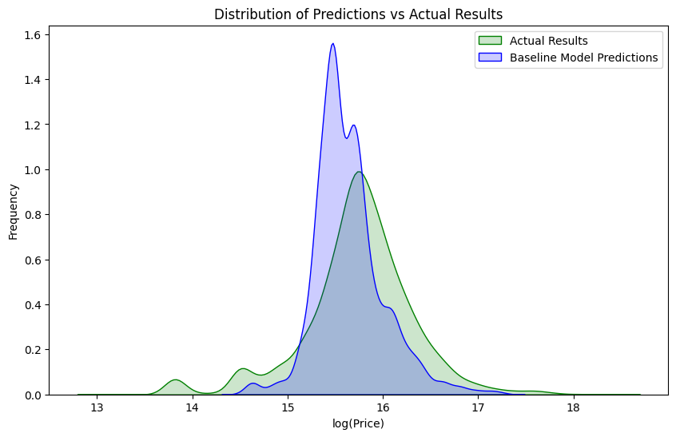
Baseline Model Performance & Kaggle Submission
Kaggle Submission Result:
Public- 0.38735
Private- 0.38628

Slide 4
Model Enhancement - Key Components

Slide 5
Feature Engineering
The motivation behind the feature engineering was using economic criteria which in turn influence behavior in the housing market, such as inflation, the cost of raw materials, the interest rate on a mortgage, etc.
To create those, we imported the macro data that contained related data and used manipulations such as moving average over a quarterly time period to track changes in interest rates, inflation and household income based on the Consumer Price Index, income from fuel prices and changes in the currency exchange rate.

Slide 6
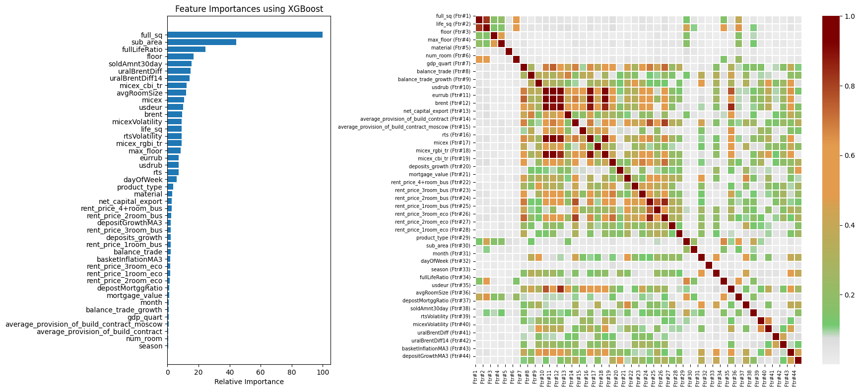
Feature Selection
For selecting the features, we tried to help the models avoid multicollinearity while maintaining the features with the most information in them.
To do so we created a correlation matrix and noticed many small and large groups of features who are correlated with each other.

Slide 7
Feature Selection - Continued
For each group (as long there is more than one feature) we kept only the features with importance level above the group’s average importance level, and depending on the model we ended up with different sets of features, but a few always prevailed due to their importance
And then according to the importance levels of the features left, we chose how many from the top to keep for the modeling.

Slide 8
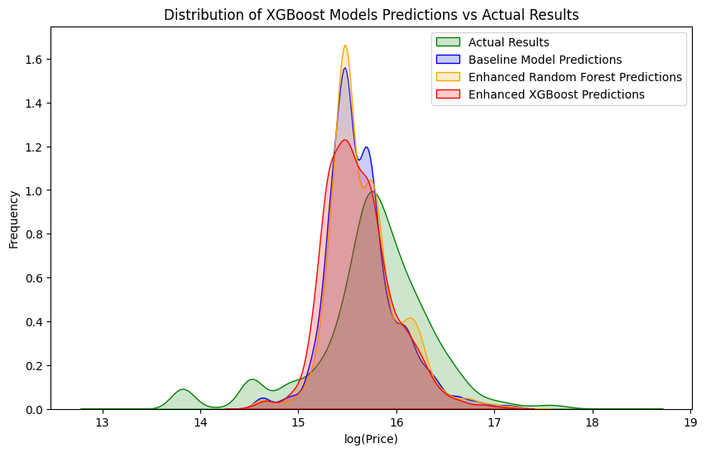
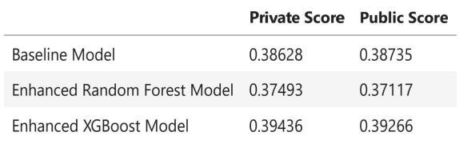
Enhanced Models – Performances

Slide 9
State-Of-The-Art Techniques
We implemented 4 techniques that were mentioned in the winners’ solution
Spliting the model by product_type’s feature value: we did not think of this technique but in hindsight it makes sense perfectly, the housing market for Investment apartments and for Renting apartments are similar in part, but they have many differences too that our original model might capture as noise.
The last technique is one we did not had enough time to apply and it is using magic numbers.
Separate data cleaning for the models: as a continuation to the previous technique they also perform the data cleaning for each model individually.
Splitting full_sq to different values in accordance with the different categorical values of different features- this was not done completely the same as described in the winners’ solution, we’ve done so in accordance with time as well as the different categorical values, for each month and year and category in some feature we made a value correspondent to that, and that also to multiple different categorical features.

Slide 10
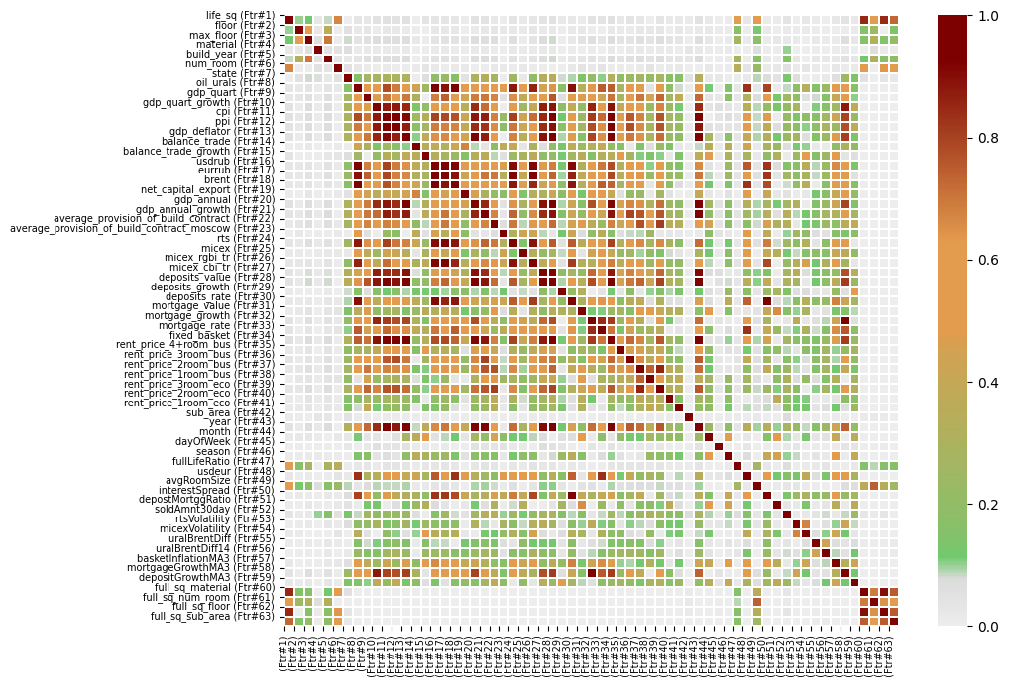
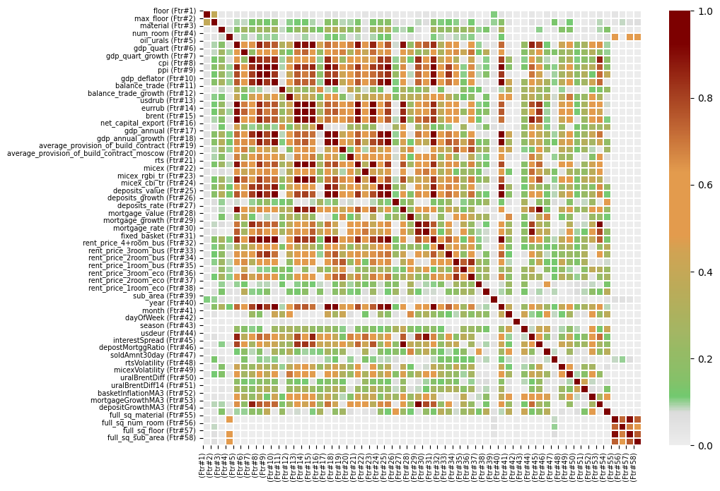
Feature Selection
Investment
Owner-Occupier

Slide 11
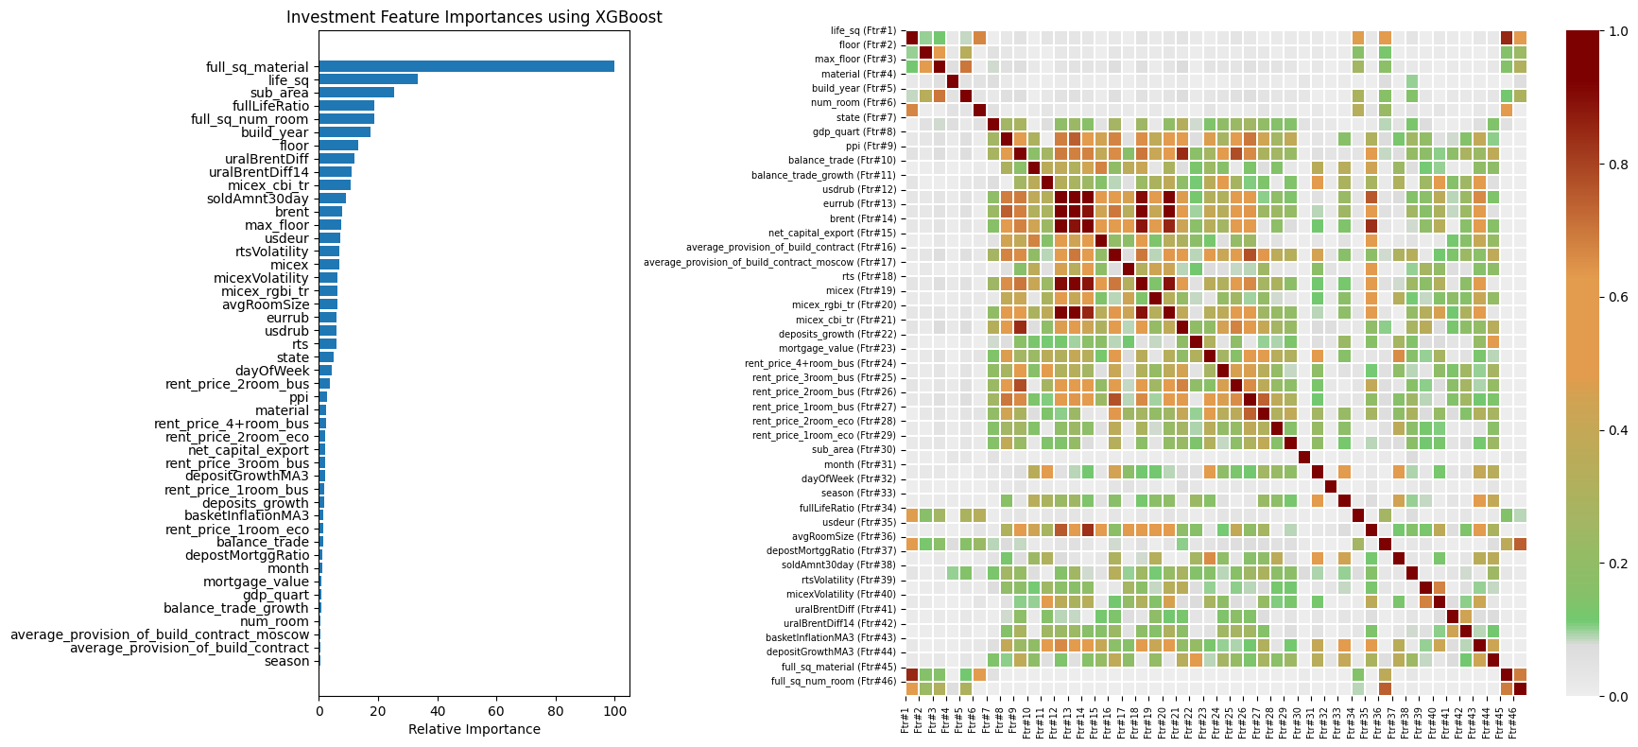
Feature Selection – Investment

Slide 12
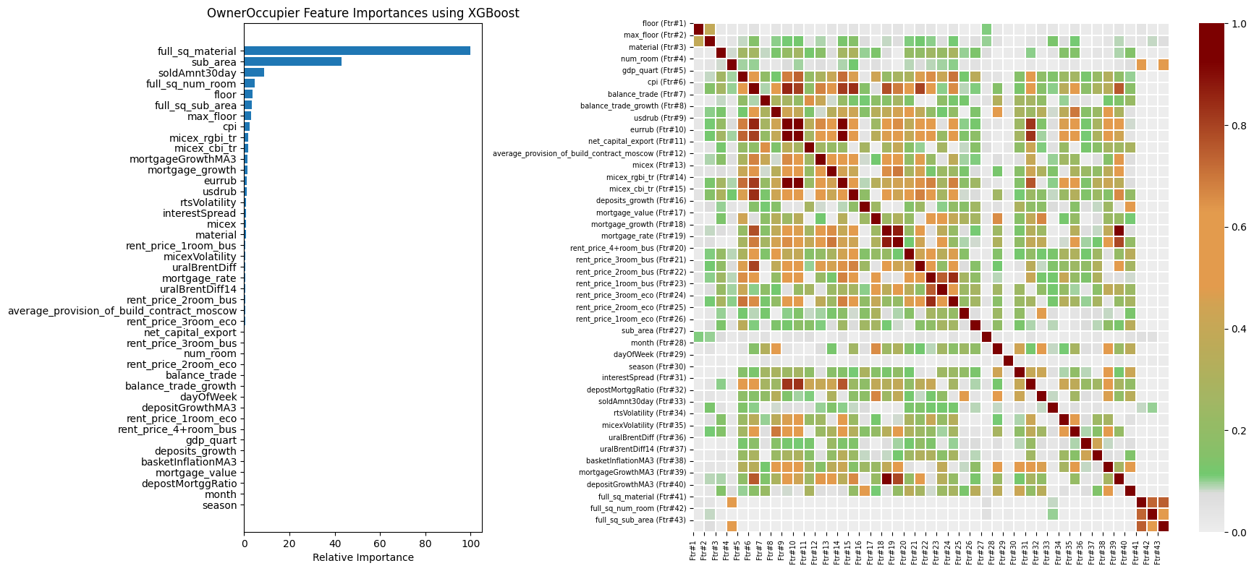
Feature Selection – Owner-Occupier

Slide 13
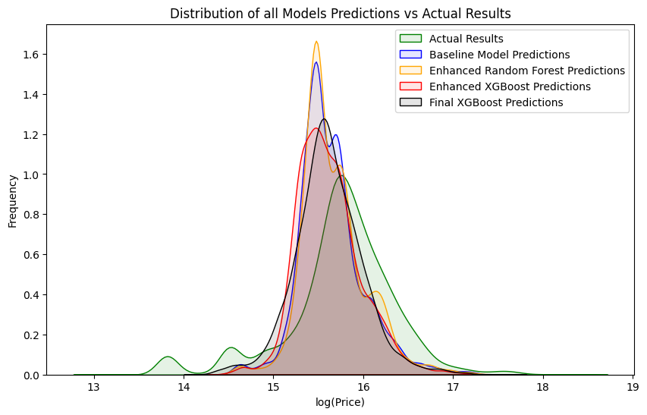
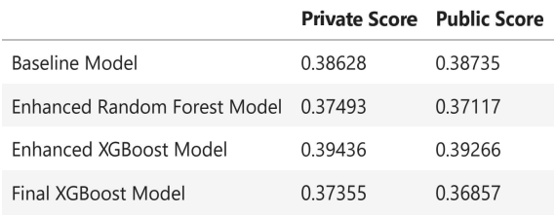
Final Model – Performance

